Slide 1
PHISHING SIMULATION
May 2022, Glassdoor Reviews

Slide 2
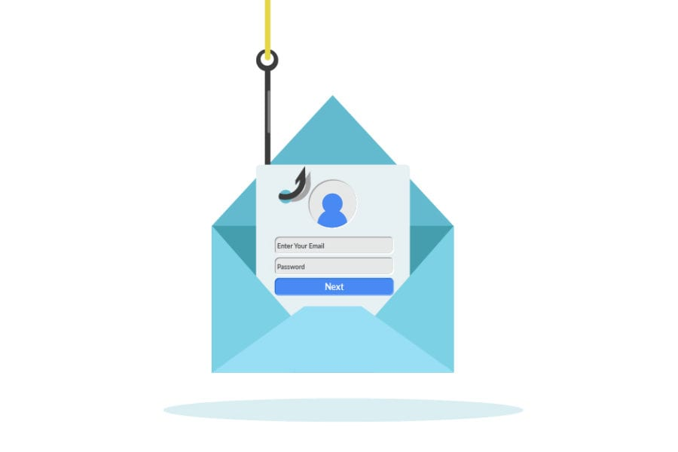
Emails
Sent
Emails Opened
47%
(370)
Clicked On Link
Phishing Rate
788
22%
(177)
22%
Reported using Phish Notify Button
Difficulty Level
2.79%
Notes:
Industry Average = 12% phished, 36% reported

Slide 3
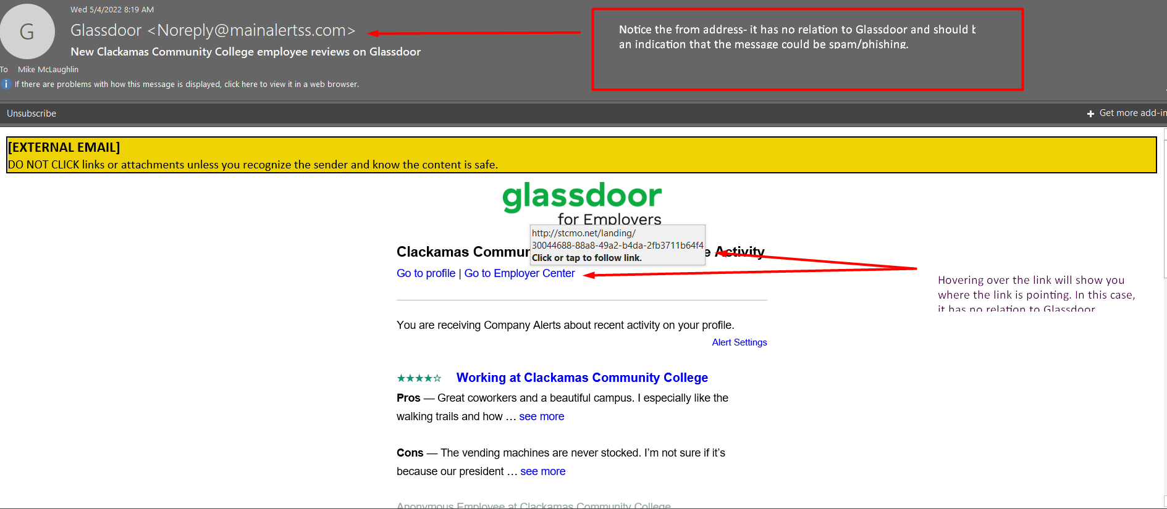

Slide 4
Questions?

